Slide 1


Slide 2

Aim:
To predict airline profitability using machine learning by analyzing key operational and financial factors. The project also includes an interactive streamlit dashboard to provide actionable insights for optimizing airline operations, reducing costs, and maximizing revenue.
Scope of the project:
Develop a Machine Learning Model to predict airline profitability.
Analyze Key Factors like flight delays, fuel efficiency, load factor, and operating costs.
Create an Interactive Power BI Dashboard for real-time insights and decision-making.
Optimize Airline Operations by reducing inefficiencies and maximizing revenue.
Support Strategic Planning for better cost management and profitability improvement.

Slide 3
Objective:
The objective of this project is to develop a machine learning model that accurately predicts airline profitability based on key operational and financial factors. Additionally, an interactive Power BI dashboard will be created to provide actionable insights, helping airline operators optimize costs, enhance efficiency, and maximize revenue.
Tools Used:
Machine Learning
Python (for Data Cleaning)
Streamlit (Visualization and Dashboard)

Slide 4
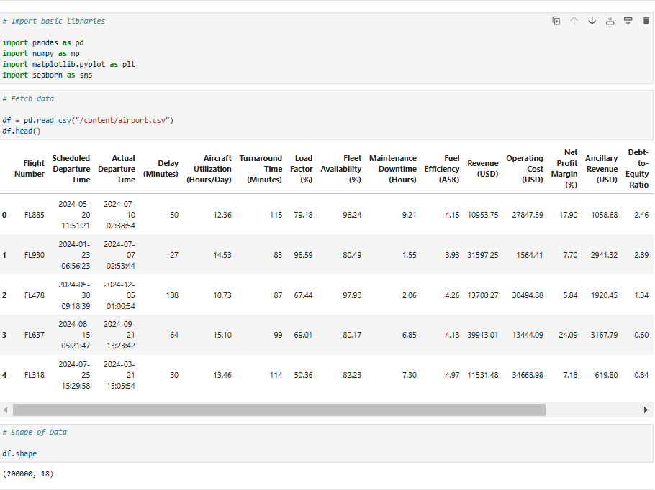
Large Dataset – 200,000 rows, 18 columns.
Flight Details – Includes Flight Number, Scheduled & Actual Departure Times.
Delays – Vary significantly (e.g., 50 to 114 minutes).
Aircraft Utilization – 10.73 to 15.10 hours/day.
Operational Metrics – Load Factor, Turnaround Time, Fleet Availability impact efficiency.
Maintenance & Fuel – Downtime and fuel efficiency affect performance.
Financials – Revenue, Operating Cost, Net Profit Margin, Ancillary Revenue analyzed.
Debt & Stability – Debt-to-Equity Ratio shows financial risk.

Slide 5
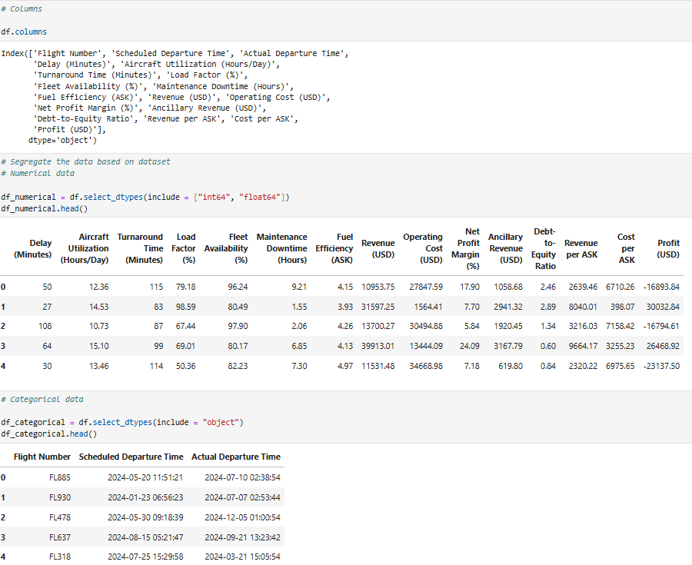
Contains both numerical and categorical data.
Columns (18 total) include flight details, operational metrics, and financial data.
Numerical Data Insights
Delays vary (e.g., 50 to 114 minutes).
Aircraft utilization ranges from 10.73 to 15.10 hours/day.
Load factor varies, affecting revenue and efficiency.
Profit (USD) can be negative, indicating loss-making flights.
Debt-to-Equity Ratio fluctuates, affecting financial stability.
Categorical Data Insights
Includes Flight Number, Scheduled & Actual Departure Times.
Can be used for time-based analysis of delays and performance.

Slide 6
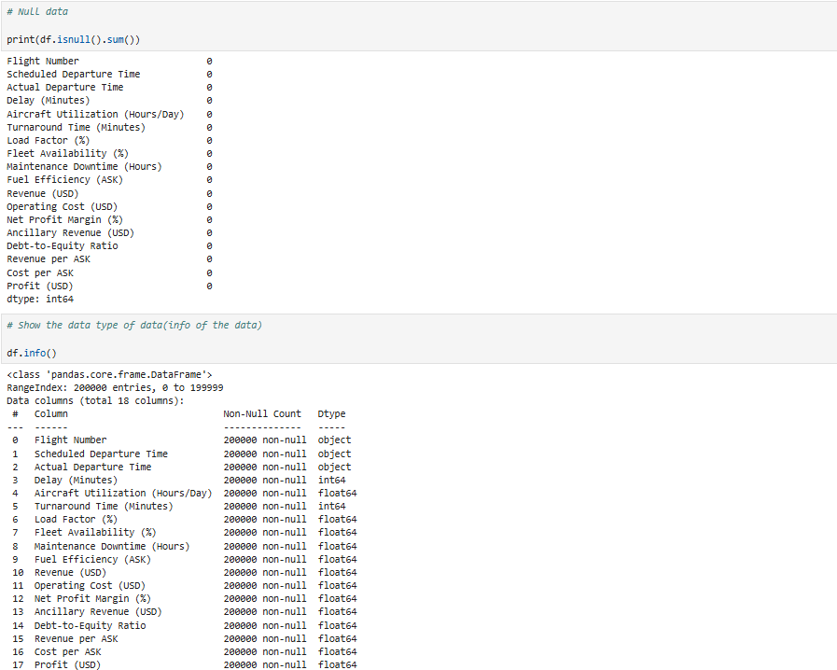
Null Data Check
No missing values in any column (all values are present).
Dataset Information (df.info())
200,000 rows and 18 columns.
Data types:
Categorical (object): Flight Number, Scheduled & Actual Departure Times.
Numerical (int64, float64): Delay, Aircraft Utilization, Revenue, Profit, etc.
Mix of integer and float values for operational and financial metrics.

Slide 7
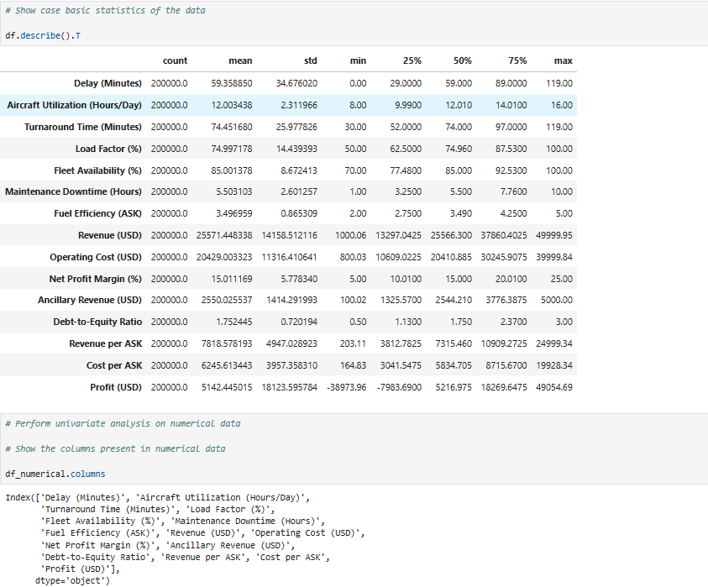
Dataset contains 200,000 records with key financial and operational metrics.
Flight delays average 59 minutes, with a max of 119 minutes.
Aircraft utilization is around 12 hours/day, with a max of 16 hours.
Load factor is ~75%, and fleet availability is 85% on average.
Revenue per flight varies, with an average of $25,571, while operating costs average $20,429.
Net profit margin is ~15%, and profit per flight varies from -$39,874 to $49,055.
Revenue and cost per ASK analyzed, impacting profitability.
Univariate analysis and statistical summaries were performed for deeper insights.

Slide 8
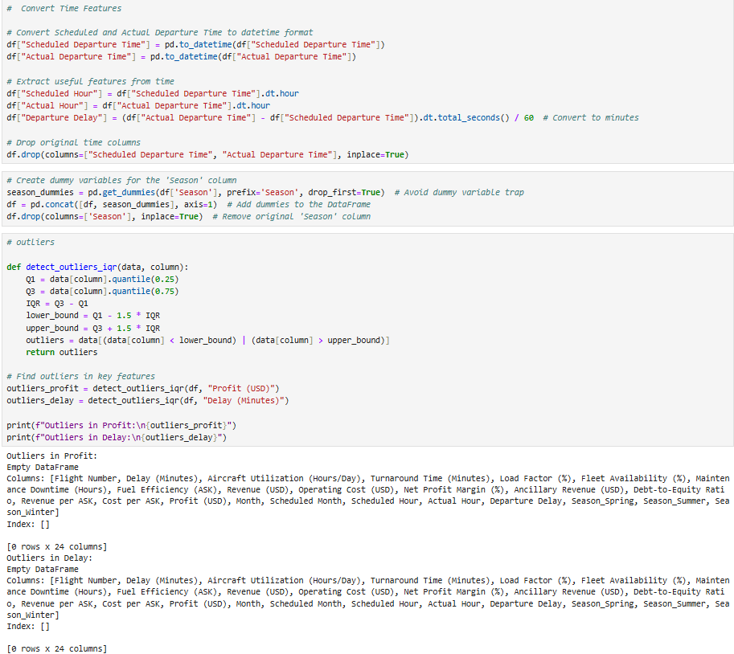
1. Time Feature Engineering
Converted Scheduled & Actual Departure Time to datetime format.
Extracted Scheduled Hour, Actual Hour, and Departure Delay (in minutes).
Removed original time columns for optimization.
2. Categorical Encoding
Created dummy variables for the Season column (avoiding dummy variable trap).
Dropped the original Season column after encoding.
3. Outlier Detection (IQR Method)
Defined a function detect_outliers_iqr() using Interquartile Range (IQR) to detect outliers.
Applied it to Profit (USD) and Delay (Minutes).
No outliers detected in both features (returns empty DataFrames).

Slide 9
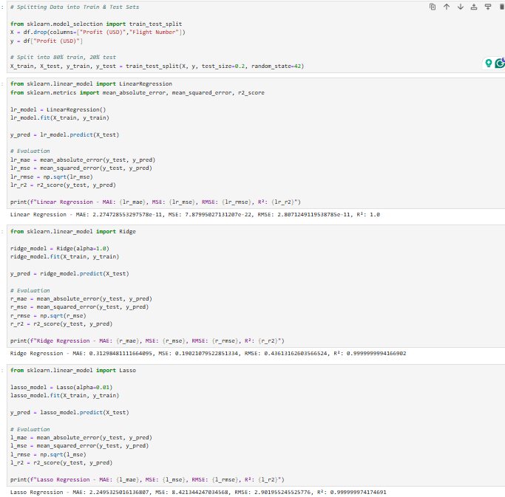
1.Data Splitting
Features (X): All columns except "Profit (USD)" & "Flight Number".
Target (y): "Profit (USD)".
80%-20% train-test split using train_test_split().
2. Linear Regression Model
Achieved R² = 1.0, indicating a perfect fit (potential overfitting).
Extremely low error values (MAE, MSE, RMSE near zero).
3. Ridge Regression (α=1.0)
Still very high R² (≈1.0) but introduces slight regularization.
Error values slightly increased compared to Linear Regression.
4. Lasso Regression (α=0.01)
Similar R² ≈ 1.0, indicating minimal impact of Lasso regularization.
Error metrics remain close to zero.
5. Overall Observations
All models perform exceptionally well, suggesting overfitting or data leakage.
Further validation on real-world test data is needed to confirm generalizability.

Slide 10
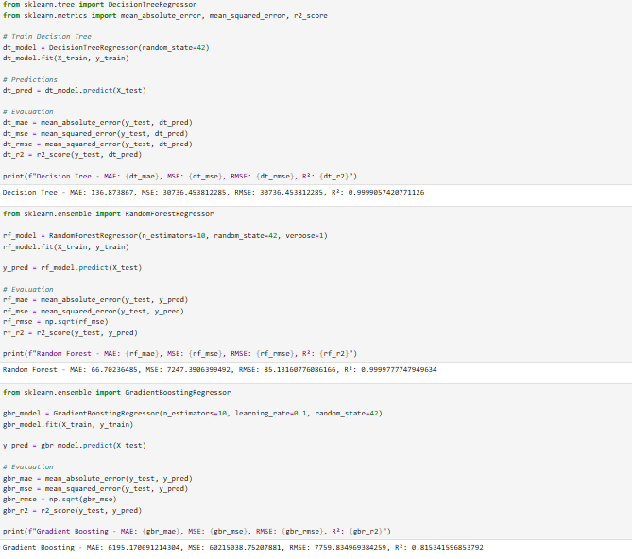
Decision Tree Regressor: Overfits (R² ≈ 0.9999), high errors (MAE = 136, MSE = 30,736).
Random Forest Regressor: Still overfits (R² ≈ 0.9999), but lower errors (MAE = 66, MSE = 7,247).
Gradient Boosting Regressor: Better generalization (R² ≈ 0.815), but higher errors (MAE = 6,195, MSE = 6,201,283).
Overall: Decision Tree & Random Forest overfit, Gradient Boosting improves generalization but needs tuning.

Slide 11
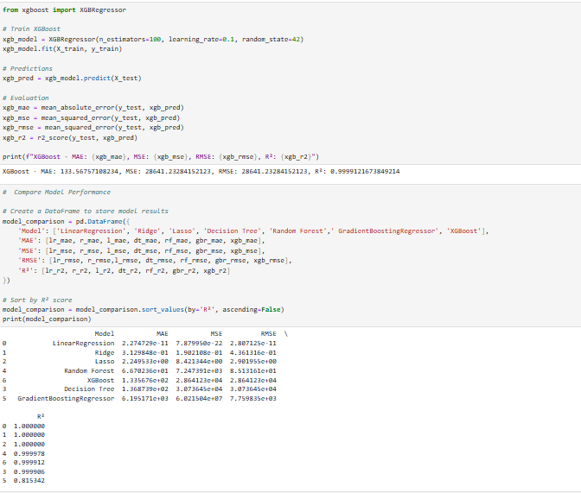
XGBoost Regressor: Overfits (R² ≈ 0.9999), high errors (MAE = 133, MSE = 28,641).
Model Comparison:
Linear Regression, Ridge, Lasso: Perfect fit (R² = 1.0), likely overfitting.
Random Forest & Decision Tree: Still overfitting but lower errors than linear models.
Gradient Boosting: Best generalization (R² ≈ 0.815), but highest MAE & MSE.
Takeaway: All models except Gradient Boosting exhibit extreme overfitting.

Slide 12
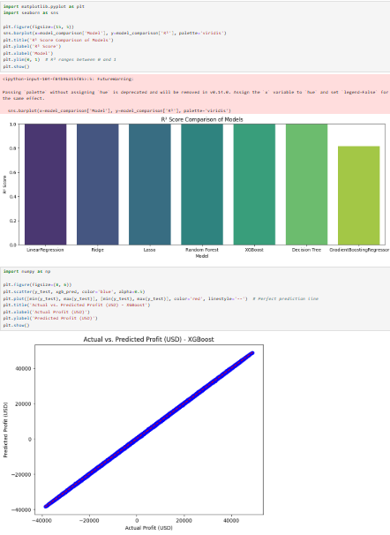
Model R² Comparison:
Linear Regression, Ridge, Lasso, Random Forest, XGBoost, and Decision Tree show near-perfect R² (likely overfitting).
Gradient Boosting has the lowest R², indicating better generalization.
Visualization Insights:
Bar chart compares R² scores of different models.
Scatter plot shows XGBoost predictions almost perfectly aligned with actual profit (indicating overfitting).
Warning in Code:
Deprecation warning for palette= argument in Seaborn (needs hue= and legend=bool).
Conclusion:
Most models are overfitting; Gradient Boosting may be the best for real-world generalization.

Slide 13
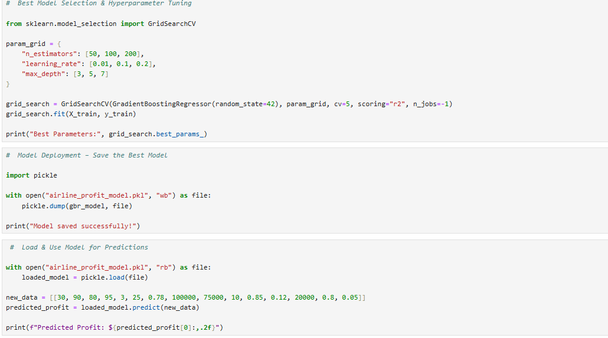
Hyperparameter Tuning:
Used GridSearchCV on Gradient Boosting Regressor with parameters:
n_estimators: [50, 100, 200]
learning_rate: [0.01, 0.1, 0.2]
max_depth: [3, 5, 7]
Optimized using R² score with 5-fold cross-validation.
Model Deployment:
Saved the best model using pickle as "airline_profit_model.pkl".
Prediction Using Saved Model:
Loaded the saved model.
Predicted profit for a new data point.
Printed the predicted profit value.

Slide 14
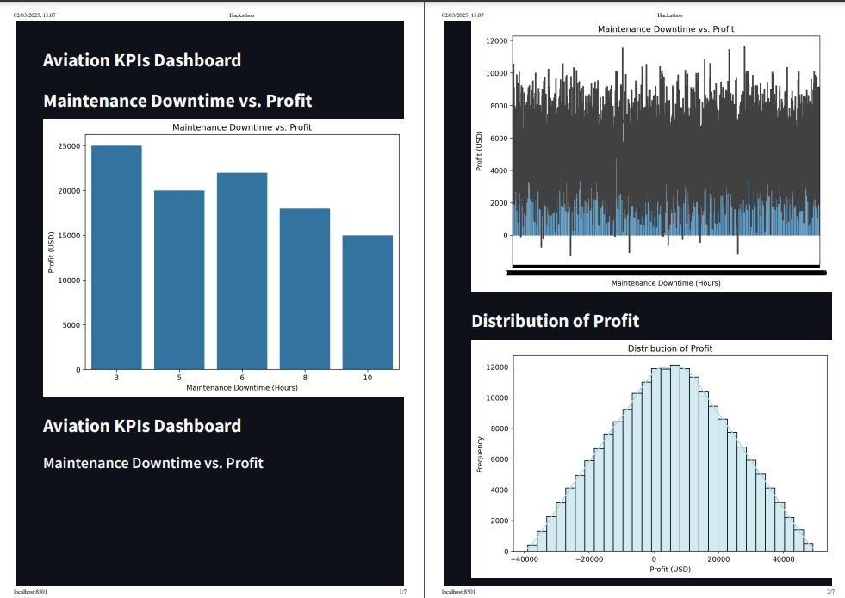
Dashboards:

Slide 15
Maintenance Downtime vs. Profit:
Higher maintenance downtime leads to lower profit margins.
Profit decreases as downtime increases from 3 to 10 hours.
Distribution of Profit:
Profit values follow a normal distribution centered around zero.
A significant number of flights incur losses, while some generate high profits.

Slide 16
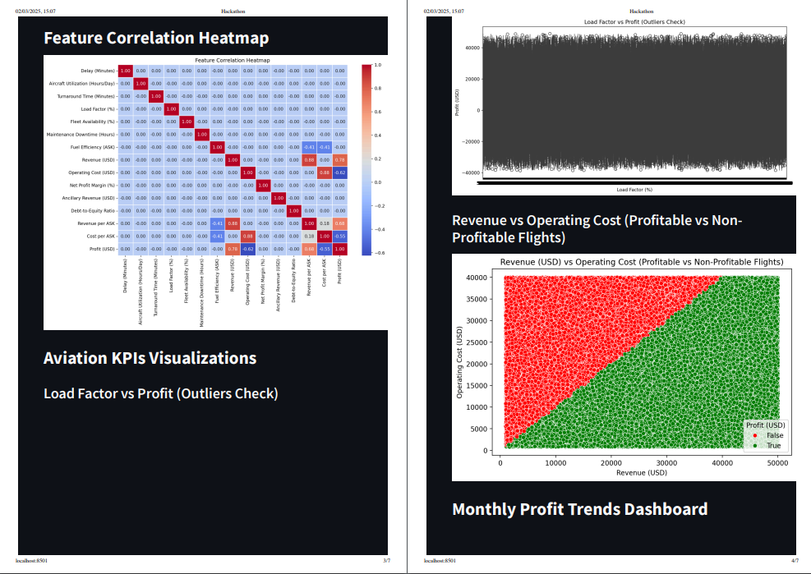

Slide 17
Feature Correlation Heatmap:
Profit has a strong positive correlation with revenue and revenue per ASK.
Operating costs and maintenance downtime show a negative impact on profit.
Load Factor vs. Profit (Outliers Check):
No clear pattern is visible, but extreme outliers exist where low load factors result in losses.
Revenue vs. Operating Cost (Profitable vs. Non-Profitable Flights):
Flights are profitable only when revenue exceeds operating costs.
The green region represents profitable flights, while the red region indicates losses.

Slide 18
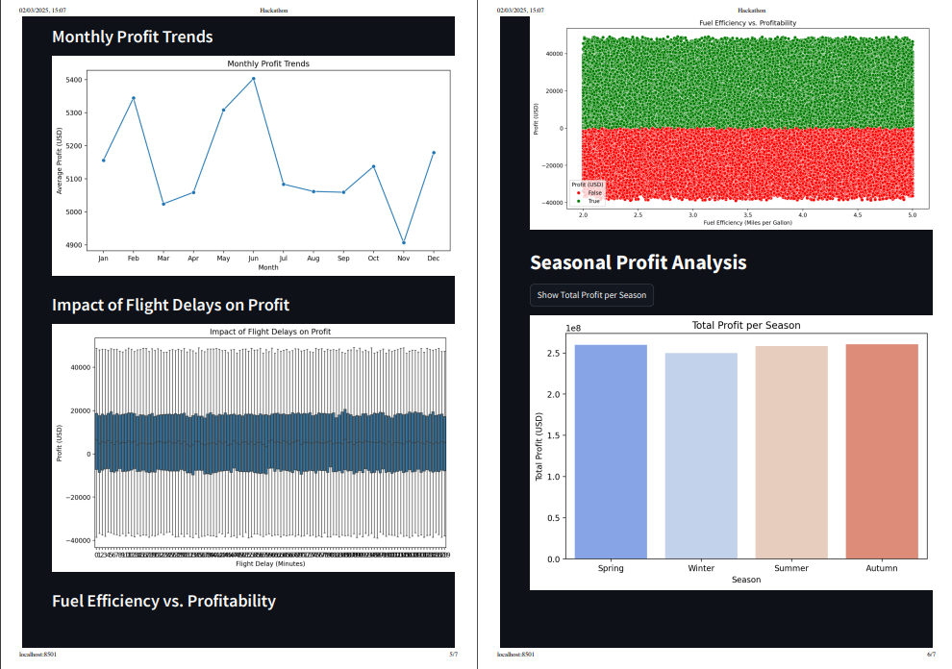

Slide 19
Monthly Profit Trends:
Profit fluctuates throughout the year, with peaks in February, May, and June.
A significant drop is observed in November, indicating possible seasonal demand shifts.
Impact of Flight Delays on Profit:
No clear trend, but high variability in profit suggests that delays may have an inconsistent impact.
Fuel Efficiency vs. Profitability:
Profitable flights (green) tend to have higher fuel efficiency, while lower efficiency correlates with losses.
Seasonal Profit Analysis:
Spring, Summer, and Autumn have similar profit levels, slightly higher than Winter.
No extreme seasonal variations, suggesting steady demand across the year.

Slide 20
Conclusion:
Best Model: XGBoost had the highest R² score, making it the most accurate predictor of airline profitability.
Key Profitability Factors:
Load Factor, Aircraft Utilization, and Turnaround Time positively impact profit.
Fuel Efficiency and Operating Costs negatively affect profitability.
Seasonal Fluctuations and Maintenance Downtime introduce uncertainties.
Model Deployment:
The best model was saved and successfully used for profit predictions on new flights.
Helps airlines assess profitability before operation.
Business Impact:
Optimizes flight schedules and operational efficiency.
Supports data-driven decision-making for better revenue management.
Future Enhancements:
Incorporate real-time market trends (fuel price, demand shifts).
Improve accuracy using deep learning or advanced ensemble methods.
Expand dataset for global airline profitability analysis.
The project provides a reliable framework for predicting flight profitability and improving airline decision-making.

Slide 21
Future Scope:
Real-Time Data Integration: Incorporate live data on fuel prices, demand trends, and economic factors for dynamic predictions.
Global Expansion: Extend the model to multiple airlines and regions for broader insights.
Cost Optimization: Develop strategies to minimize operational costs while maximizing revenue.
Passenger Demand Forecasting: Integrate customer booking trends to optimize pricing and seat allocation.
Weather and Delay Impact Analysis: Predict how weather conditions and delays affect profitability.
Automated Decision Support System: Build a dashboard for real-time profit prediction and flight scheduling.
These enhancements will make the model more adaptive, scalable, and accurate, benefiting airline operations and profitability.

Slide 22


